Slide 1


Slide 2
STAT 2600
Introduction To Data Science
Lecture 7 Day 1
03/03/2021
Introduction to Hypothesis Testing
Dr. Osita Onyejekwe
Spring 2021

Slide 3
Nonstatistical Hypothesis Testing…
A criminal trial is an example of hypothesis testing without the statistics.
In a trial a jury must decide between two hypotheses. The null hypothesis is
H₀: The defendant is innocent
The alternative hypothesis or research hypothesis is
H_{A}: The defendant is guilty
The jury does not know which hypothesis is true. They must make a decision on the basis of evidence presented.

Slide 4
Nonstatistical Hypothesis Testing…
In the language of statistics convicting the defendant is called rejecting the null hypothesis in favor of the alternative hypothesis. That is, the jury is saying that there is enough evidence to conclude that the defendant is guilty (i.e., there is enough evidence to support the alternative hypothesis).
If the jury acquits it is stating that there is not enough evidence to support the alternative hypothesis. Notice that the jury is not saying that the defendant is innocent, only that there is not enough evidence to support the alternative hypothesis. That is why we never say that we accept the null hypothesis.

Slide 5
Nonstatistical Hypothesis Testing…
There are two possible errors.
A Type I error occurs when we reject a true null hypothesis. That is, a Type I error occurs when the jury convicts an innocent person. We would want the probability of this type of error [maybe 0.001 – beyond a reasonable doubt] to be very small for a criminal trial where a conviction results in the death penalty.
P(Type I error) = α [usually 0.05 or 0.01]

Slide 6
Nonstatistical Hypothesis Testing…
A Type II error occurs when we fail to reject a false null hypothesis. That occurs when a guilty defendant is acquitted.
In practice, this type of error is by far the most serious mistake we normally make. For example, if we test the hypothesis that the amount of medication in a heart pill is equal to a value which will cure your heart problem and “accept the null hypothesis that the amount is ok”. Later on we find out that the average amount is WAY too large and people die from “too much medication” [I wish we had rejected the hypothesis and threw the pills in the trash can], it’s too late because we shipped the pills to the public.

Slide 7
Nonstatistical Hypothesis Testing…
The probability of a Type I error is denoted as α (Greek letter alpha). The probability of a type II error is β (Greek letter beta).
The two probabilities are inversely related. Decreasing one increases the other, for a fixed sample size.
In other words, you can’t have α and β both real small for any old sample size. You may have to take a much larger sample size, or in the court example, you need much more evidence.

Slide 8

Types of Errors…
A Type I error occurs when we reject a true null hypothesis (i.e. Reject H₀ when it is TRUE)
A Type II error occurs when we fail to reject a false null hypothesis (i.e. Do NOT reject H₀ when it is FALSE)
H₀ | T | F
Reject | I
Reject |  | II

Slide 9
Nonstatistical Hypothesis Testing…
The critical concepts are theses:
There are two hypotheses, the null and the alternative hypotheses.
The procedure begins with the assumption that the null hypothesis is true.
The goal is to determine whether there is enough evidence to infer that the alternative hypothesis is true, or the null is not likely to be true.
There are two possible decisions:
Conclude that there is enough evidence to support the alternative hypothesis. Reject the null.
Conclude that there is not enough evidence to support the alternative hypothesis. Fail to reject the null.

Slide 10
Concepts of Hypothesis Testing (1)…
The two hypotheses are called the null hypothesis and the other the alternative or research hypothesis. The usual notation is:
H₀: — the null hypothesis
H_{A}: — the alternative hypothesis
The null hypothesis (H₀) will always state that the parameter equals the value specified in the alternative hypothesis (H_{A})
pronounced
H “nought”

Slide 11


Concepts of Hypothesis Testing…
Consider the average or mean demand for computers during assembly lead time. Rather than estimate the mean demand, our operations manager wants to know whether the mean is different from 350 units. In other words, someone is claiming that the mean time is 350 units and we want to check this claim out to see if it appears reasonable. We can rephrase this request into a test of the hypothesis:
H₀: = 350 units
Thus, our research hypothesis becomes:
H_{A}: ≠ 350 units
This will be a two-sided test.
The standard deviation σ is to be 75, the sample size n is 25, and the sample mean is 370.16

Slide 12
Concepts of Hypothesis Testing…
If we’re trying to decide whether the mean is not equal to 350, a large value of (600), then would provide enough evidence.
If is close to 350 (say, 355) we could not say that this provides a great deal of evidence to infer that the population mean is different than 350.

Slide 13
Concepts of Hypothesis Testing
The two possible decisions that can be made:
Conclude that there is enough evidence to support the alternative hypothesis
(also stated as: reject the null hypothesis in favor of the alternative)
Conclude that there is not enough evidence to support the alternative hypothesis
(also stated as: failing to reject the null hypothesis in favor of the alternative)
NOTE: we do not say that we accept the null hypothesis.

Slide 14


Concepts of Hypothesis Testing…
The testing procedure begins with the assumption that the null hypothesis is true.
Thus, until we have further statistical evidence, we will assume:
H₀: µ= 350 units (assumed to be TRUE)
The next step will be to determine the sampling distribution of the sample mean assuming the true mean is 350.
is normal with 350

Slide 15
Is the Sample Mean in the “Guts” of the Sampling Distribution??

Slide 16
Is the Sample Mean in the “Guts” of the Sampling Distribution??
Method # 1: The Unstandardized Test Statistic Approach
Is in the guts of the sampling distribution? It depends on what you define as the “guts” of the sampling distribution.
If we define the guts as the center 95% of the distribution [this means α = 0.05], then the critical values that define the guts will be 1.96 standard deviations from x-bar on either side of the mean of the sampling distribution [350], or
Upper bound = 350 + 1.96*15 = 350 + 29.4 = 379.4 units
Lower bound = 350 – 1.96*15 = 350 – 29.4 = 320.6 units

Slide 17
Unstandardized Test Statistic Approach
This is a two-sided test, so we have one of two possible regions of rejection.
The sample mean is located in the 95% region, so we fail to reject the null hypotheses.

Slide 18

Is the Z-score of the sample mean located within the guts of the sampling distribution or is it located in the reject region outside of the “guts”?
Method # 2: The Standardized Test Statistic Approach
We defined the “guts” of the sampling distribution to be the center 95% [α = 0.05]. The remaining 5% is split up into the two tails.
If the Z-Score for the sample mean is greater than 1.96, we know that will be in the reject region on the right side or…
If the Z-Score for the sample mean is less than -1.97, we know
that will be in the reject region on the left side.
Is this Z-Score in the guts of the sampling distribution?

Slide 19
2. Standardized Test Statistic Approach

Slide 20
Is the p-value higher or lower than the alpha level?
Method # 3: The p-value approach
The p-value approach is generally used with a calculator. Will the “Rejection Region” “capture” the sample mean?
For this example, since is to the right of the mean, calculate
P( > 370.16) = P(Z > 1.344) = 0.0901
Since this is a two tailed test, you must double this area for the p-value.
p-value = 2*(0.0901) = 0.1802
Since we defined the guts as the center 95% [α = 0.05], the reject region is the other 5%. Since our sample mean, , is in the 18.02% region, it cannot be in our 5% rejection region [α = 0.05].

Slide 21
The p-value approach
“The p-value is low, so let it go (we fail to reject the null hypotheses)”

Slide 22
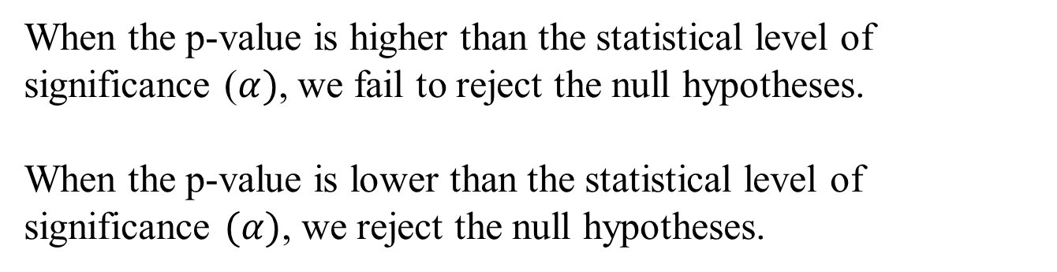
The P-value approach
When referring to the p-value…
“When it’s low, let it go. We reject the null hypotheses.
When it’s high, let it fly, so we fail to reject the null hypotheses.”
11.22

Slide 23
Statistical Conclusions:
Unstandardized Test Statistic:
Since LCV (320.6) < (370.16) < UCV (379.4), we reject the null hypothesis at a 5% level of significance.
Standardized Test Statistic:
Since -Z_{α/2}(-1.96) < Z(1.344) < Z_{α/2} (1.96), we fail to reject the null hypothesis at a 5% level of significance.
P-value:
Since p-value (0.1802) > 0.05 [α], we fail to reject the hull hypothesis at a 5% level of significance.

Slide 24
Example…
A department store manager determines that a new billing system will be cost-effective only if the mean monthly account is more than $170.
A random sample of 400 monthly accounts is drawn, for which the sample mean is $178. The accounts are approximately normally distributed with a standard deviation of $65.
Can we conclude that the new system will be cost-effective?

Slide 25

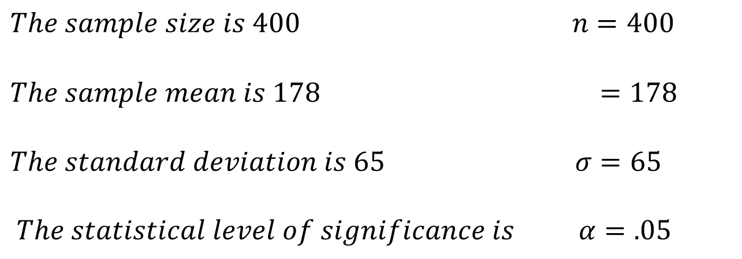
Example…
The system will be cost effective if the mean account balance for all customers is greater than $170. We express this belief as our research hypothesis:

Slide 26
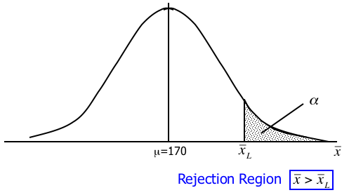
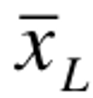
Example… The Rejection Region
The rejection region is a range of values such that if the test statistic falls into that range, we decide to reject the null hypothesis in favor of the alternative hypothesis.
is the critical value of to reject H₀.

Slide 27
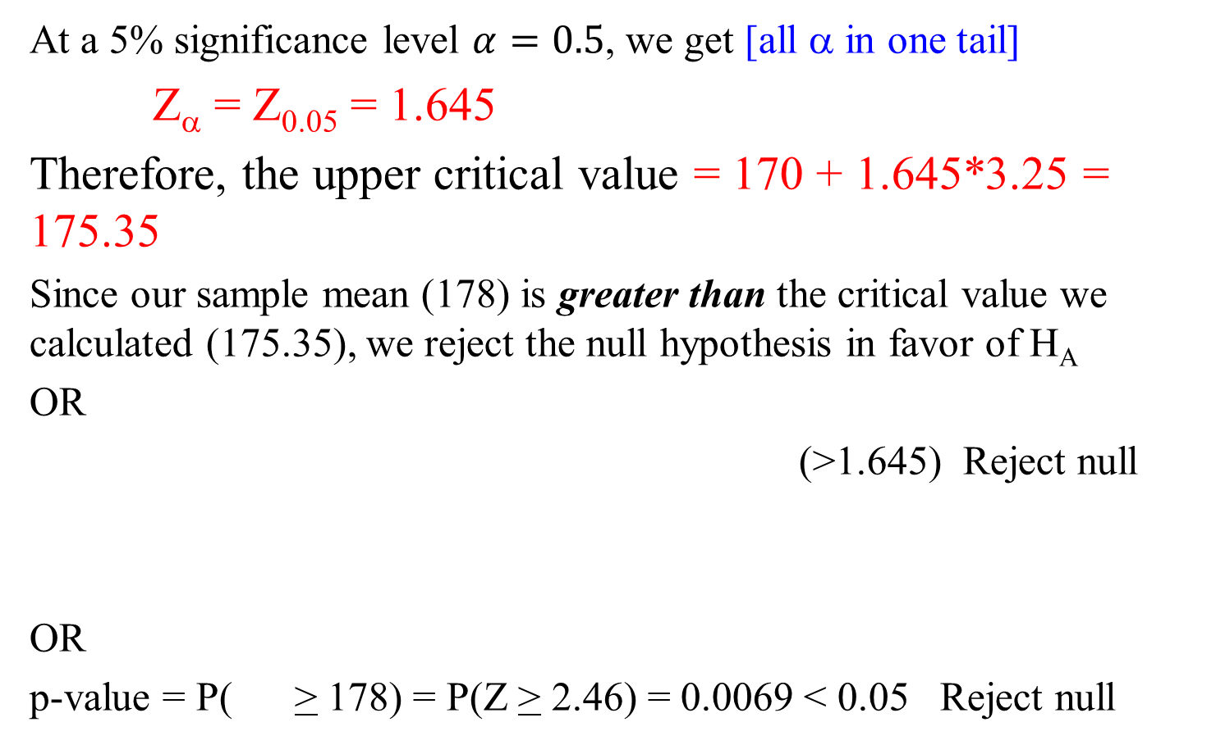
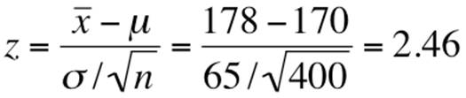
Example…

Slide 28



Example… The Big Picture…
=175.34
=178
Reject H₀ in favor of

Slide 29
Interpreting the p-value…
The smaller the p-value, the more statistical evidence exists to support the alternative hypothesis.
If the p-value is less than 1%, there is overwhelming evidence that supports the alternative hypothesis.
If the p-value is between 1% and 5%, there is a strong evidence that supports the alternative hypothesis.
If the p-value is between 5% and 10% there is a weak evidence that supports the alternative hypothesis.
If the p-value exceeds 10%, there is no evidence that supports the alternative hypothesis.
We observe a p-value of .0069, hence there is overwhelming evidence to support H_{A}: > $170.

Slide 30
Interpreting the p-value…
Overwhelming Evidence
(Highly Significant)
Strong Evidence
(Significant)
Weak Evidence
(Not Significant)
No Evidence
(Not Significant)
0 .01 .05 .10
p=.0069

Slide 31
Conclusions of a Test of Hypothesis…
If we reject the null hypothesis, we conclude that there is enough evidence to infer that the alternative hypothesis is true.
If we fail to reject the null hypothesis, we conclude that there is not enough statistical evidence to infer that the alternative hypothesis is true. This does not mean that we have proven that the null hypothesis is true!
Keep in mind that committing a Type I error OR a Type II error can be VERY bad depending on the problem.

Slide 32
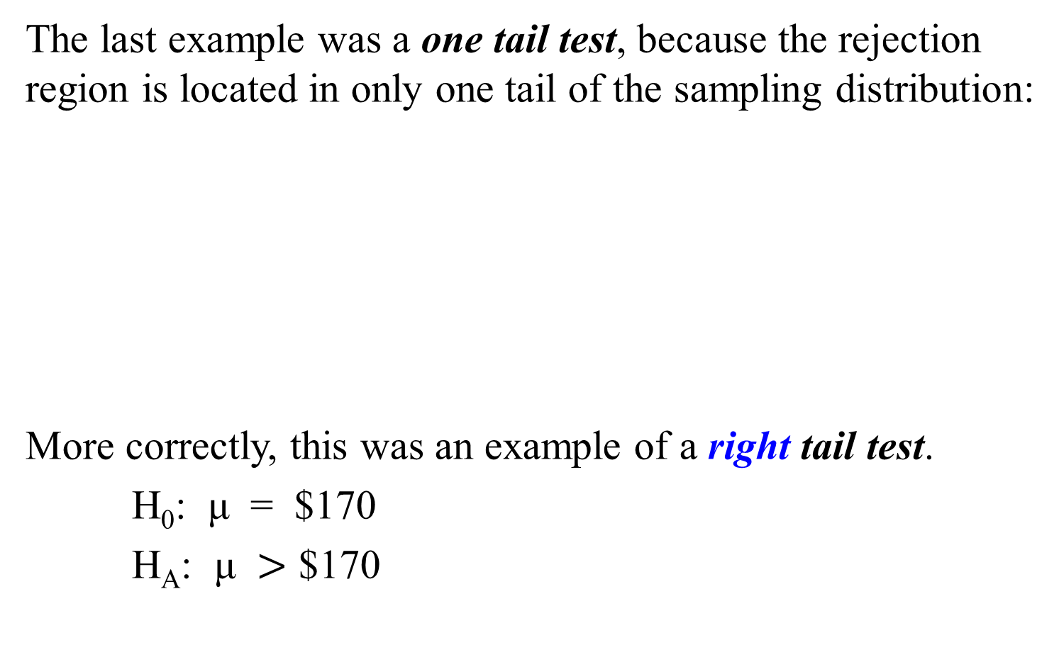
One tail test with rejection region on right

Slide 33
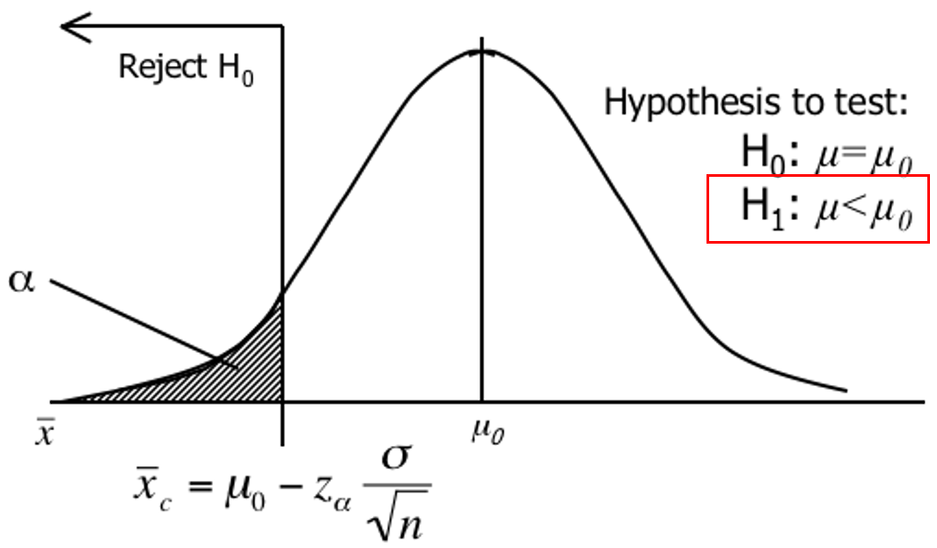
One tail test with rejection region on left
The rejection region will be in the left tail.

Slide 34
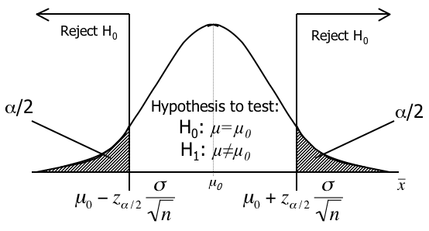
Two tail test with rejection region in both tails
The rejection region is split equally between the two tails.

Slide 35
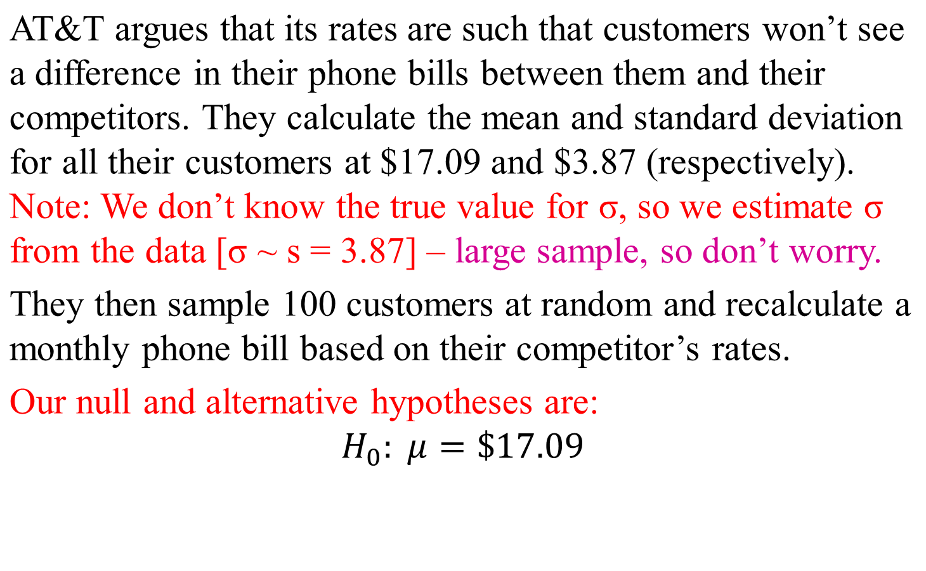
Example… Students work

Slide 36
Example…
The rejection region is set up so we can reject the null hypothesis when the test statistic is large or when it is small.
That is, we set up a two-tail rejection region. The total area in the rejection region must sum to , so we divide α by 2.
stat is “small”
stat is “large”

Slide 37
Example…
At a 5% significance level (i.e. = .05), we have
/2 = .025. Thus, z_{.025} = 1.96 and our rejection region is:
z < –1.96 -or- z > 1.96

Slide 38


Example 2…
AT&T study reported that = 17.55
Using our standardized test statistic:
We find that:
Since z = 1.19 is not greater than 1.96, nor less than –1.96 we cannot reject the null hypothesis in favor of H_{A}. That is “there is insufficient evidence to infer that there is a difference between the bills of AT&T and the competitor.”

Slide 39
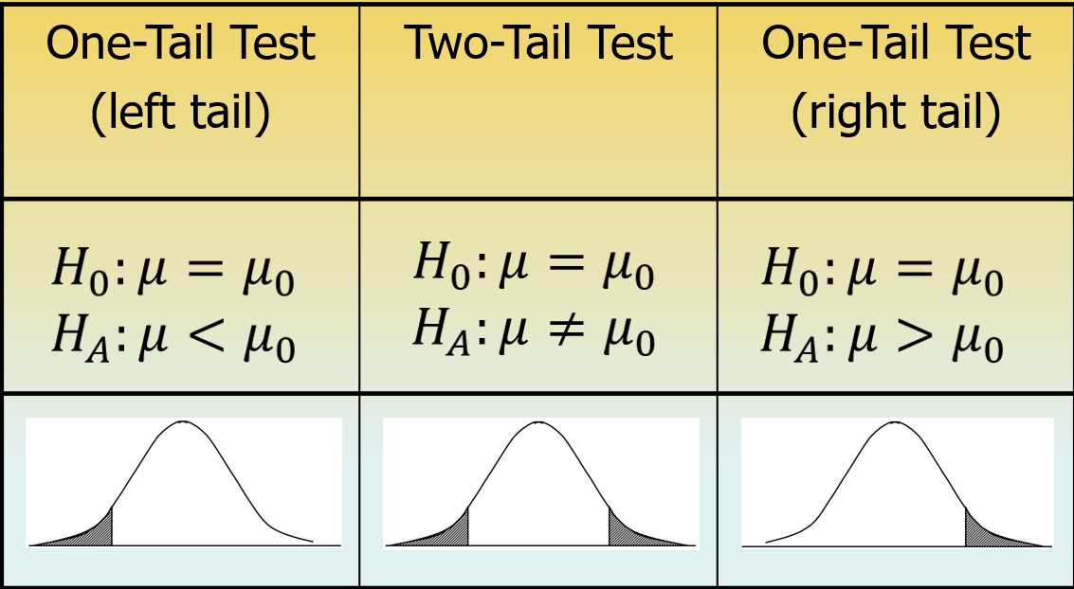
Summary of One- and Two-Tail Tests…

